Slide 1
Spring Socials 2025
Games Group

Slide 2
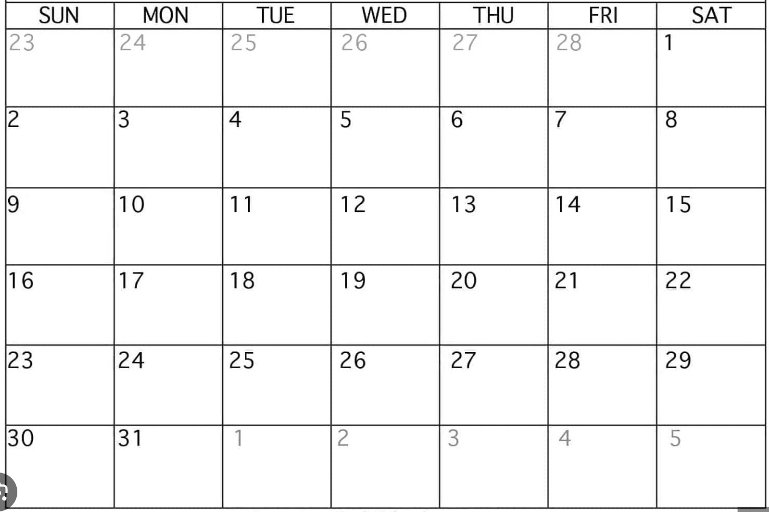
March
Hosted by Simran
Hosted by Miral
Finals Week
Hosted by Saman
Hosted by Divakar
Spraaang Break
Hosted by Aakash
Pandemic & Splendor MPP 6ppl
Hosted by Riti

Slide 3
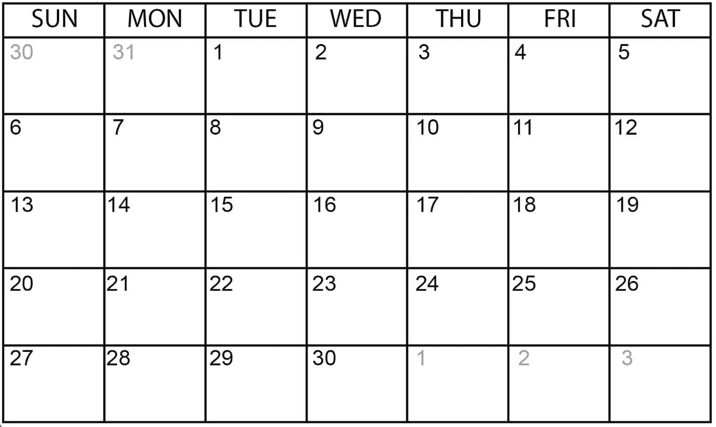
April
Hosted by Simran
Hosted by Miral
Citadel
8 ppl
Hosted by Saman
Card Games MPP 10 ppl
Hosted by Divakar
Hosted by Aakash
Hosted by Riti
Word Games MPP 10 ppl

Slide 4
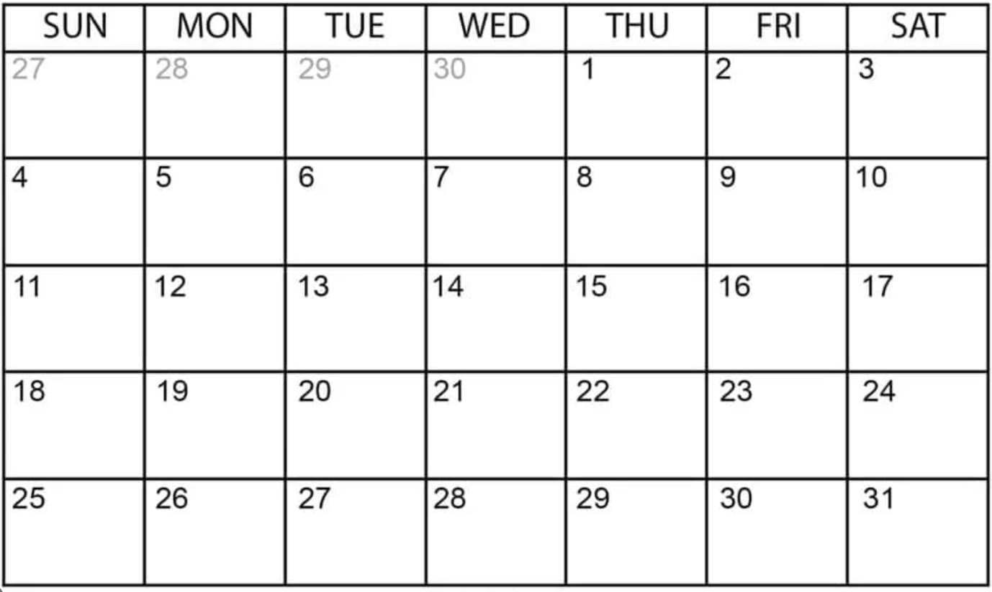
May
Word Games MPP 12 ppl
Hosted by Simran
Hosted by Miral
Hosted by Miral
Hosted by Saman
Strategy Games 10 ppl
Dice Games 10 ppl
Hosted by Divakar
Orlean
7 ppl
Powergrid + Pandemic 10 ppl
Hosted by Aakash
Hosted by Riti
Finals Week

Slide 5
Large Group Events (Planning)

Slide 6
Desi Game Night - Spring 2025 - Riti & Divakar
For the tournament games, please sign up for at most 3 games you want to participate in (Tournament Sign-up Form).
Tournament Games and rewards (all cash amounts will be paid in the form of Amazon gift cards):
Ludo - Winner gets $10 + Ludo game. Runner-up gets Ludo game
Carrom - Winner gets $20
Chess - Winner gets $10 + Chess game
Housie - $5 for each line. $10 for full house
Odd/Eve - Winner gets $5
Book Cricket - Winner gets $5
3 Patti - Variable based on pot size
Casual Games:
Saanp Seedi (Snakes and Ladders)
Rummy
Bluff

Slide 7
Escape Rooms - Spring 2025 - Miral, Aakash, Simran
Date/Times Winter Quarter:
Sunday 3/30 - Rob the Mob at PanIQ in Fulton Market – Miral
Monday 4/7 - Haunted Hotel at Great Escape Game in River North – Aakash
Thursday 4/10 - Voodoo Spirits at PanIQ in Fulton Market – Simran
Official Ratings / Notes:
Rob the Mob
Haunted Hotel
Voodoo Spirits - somewhat easy for being a 9/10 difficulty. 5 people finished in 25 minutes

Slide 8
Large Group Event Ideas
New Ideas
Trivia night
Mini golf
Chess Tournament
Assassin
Done Previously
Snakes & Lattes
Escape Rooms
Activate!
Arcade Bar

Slide 9
Large Group Events (historical)

Slide 10
Escape Rooms - Winter 2025 - Organized by Simran
Date/Times Winter Quarter:
Thursday 1/16 1:40pm - Mysterious Market (5 people)
Friday 1/17 11:00am - Prison Break (4 people)
Friday 1/17 11:00am - Mysterious Market (4 people)
Friday 1/17 11:20am - The Heist (4 people)
Official Ratings:
Gold Rush = 7/10 difficulty
Mysterious Market, The Heist, Mission Mars** = 8/10 difficulty
Prison Break = 9/10 difficulty
** Mission Mars felt easier – like a 6 or 7 out of 10; Mysterious Market felt harder (9/10)

Slide 11
Activate - Winter 2025 - Led by Simran
https://playactivate.com/
13 people per reservation
$25/person – charge $15 for members
Pay for ubers there and back for those without cars

